Slide 1
Artist Websites
Created by: Keesha Jimenez

Slide 3
Why an Artist Website?
Keeps your artwork in one place
Allows you to build a network with other artists
Acts like a huge portfolio and resume
Interact with fans with creating events
Allows fans to message you for commissions
Sells you as an artist
Helps give fans a place to get to know you!

Slide 4
Do your Research!
What website do I want to use?
How much am I willing to spend?
Do I need help to create a website?
Do I need to know HTML or CSS coding?
What do I want the patrons to know about me as an artist?
Do I need a shop?
Do I need Twitter? Instagram? Facebook?

Slide 5
Website Builders

Slide 6
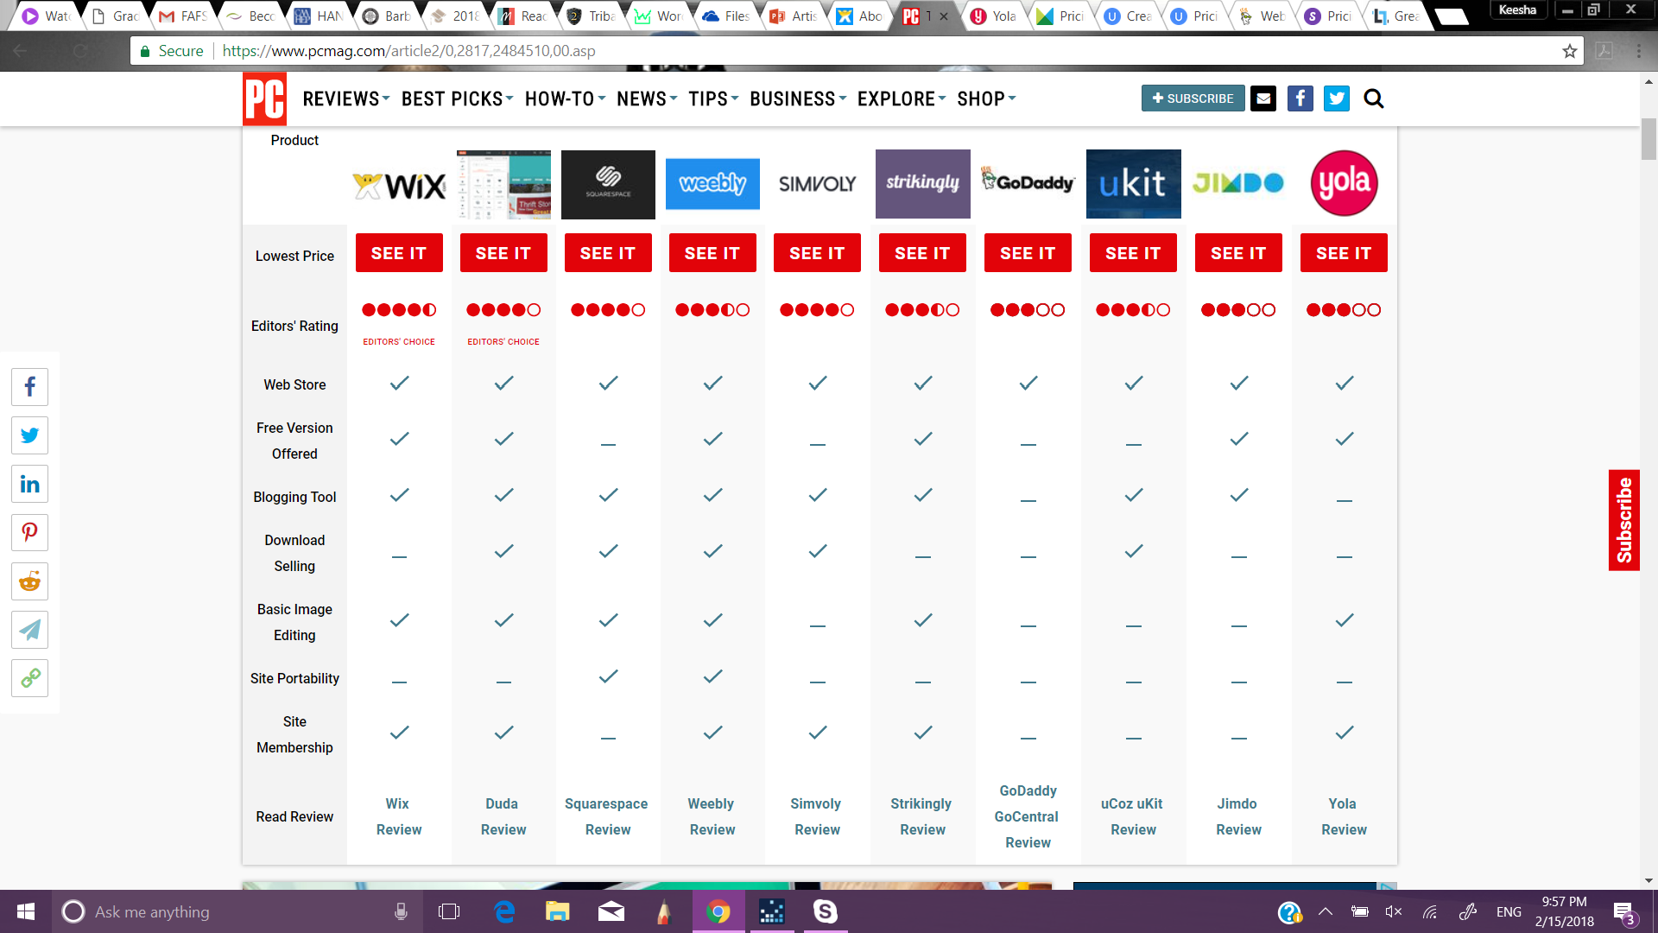

Slide 7
How many are there?
Most Popular
www.wix.com
www.weebly.com
www.godaddy.com
www.squarespace.com
New
www.duda.co
www.simvoly.com
www.strikingly.com
www.ucoz.com
www.jimdo.com
www.yola.com

Slide 8
How much do I want to spend?
DEPENDS!
Majority are free to start
Features are limited based on price and website
Hosting
SEO Analytics
Pages
Support
Etc.

Slide 9
Does the website have professional builders?
YES!
It will cost you.
They consult with you and dictate what the site would look like
They add photos to start
Set up SEO Analytics if possible
Etc.
Check out websites about what they do for you

Slide 10
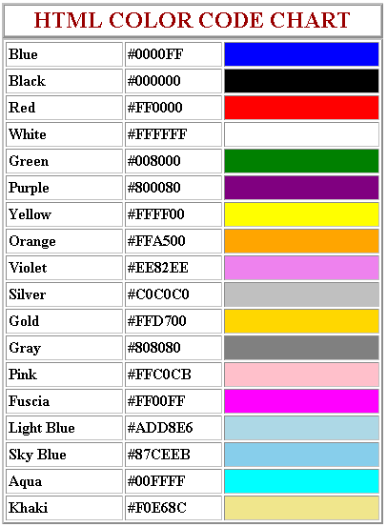
Do I need to know HTML or CSS coding?
Depends on the website!
In edit mode, they give you option to do HTML or CSS coding
Advanced people use this feature
Color is popular choice for HTML coding
Search for simple HTML coding for color or font you can use if you don't like what the website provides you.
If not, you don't need to use it.

Slide 11
Formatting

Slide 12
What is formatted?
Background
Font
Content

Slide 13
Background
Keep it professional
Can express with color or theme
Full screen image of artwork

Slide 14
Fonts?
Use:
Don’t use:
Arial
Courier
Georgia
Times New Roman
Veranda
Chiller
Brush Script
Magneto
Pristina
Vivaldi
Make sure it is legible

Slide 15
How to Format the Content?
Make sure it is within page width
Change size of content appropriately
Update webpage to fit with new items
KEEP UP TO DATE!

Slide 16
On the Website

Slide 17
What do I want them to know?
Biography
Exhibitions (Past and future)
CV or resume
Gallery
Contact
Shop

Slide 18
Biography
IMPORTANT PART OF WEBSITE!
Length depends on you
Ask yourself:
What inspired me to be an artist?
How long have I been doing this professionally?
What process or medium am I using?
Did I go to school to be an artist?
What do I expect from my patrons (fans/contributors)?
ALSO KNOWN AS ABOUT ME

Slide 19
Exhibitions
Where did I show my artwork?
When did I show them?
Was it a group exhibition?
Was it a solo exhibition?
What was the theme?
Keep the pamphlets to plug the information!
If future event, post it on home page or Facebook page

Slide 20
Curriculum Verbatim
May Include:
Personal Information
Education
Exhibitions
Bibliographies
Newspaper and magazine articles
Collections
Private and gallery collections
Texts
Articles you wrote
Teaching
Guest speaker or workshop
Faculty teacher
Curatorial Projects
Worked with a huge gallery and placed artwork in exhibition
Awards and Grants
Residency
https://thepracticalartworld.com/2011/02/12/how-to-write-an-artists-cv-in-10-steps/

Slide 21
Gallery
May categorize as:
Drawings
Paintings
Photography
Jewelry
Etc.
Photographs of artwork:
Black or white background
Positioned straight in camera
High depth quality
Not shaky or blurry
PHOTOGRAPHS MUST BE PROFESSIONALLY DONE. NOT FROM PHONE!​

Slide 22
Contact
Format it however you like
May include your artist name
Can be positioned anywhere on Contact Us page

Slide 23
Shop
Benefits of a shop:
Artwork in one place
Sell artwork
Exposure all around the world
Control of price
Disadvantages of a shop:
Competition
Commission towards website
Gain only royalty
Prices can get too expensive for customers

Slide 24
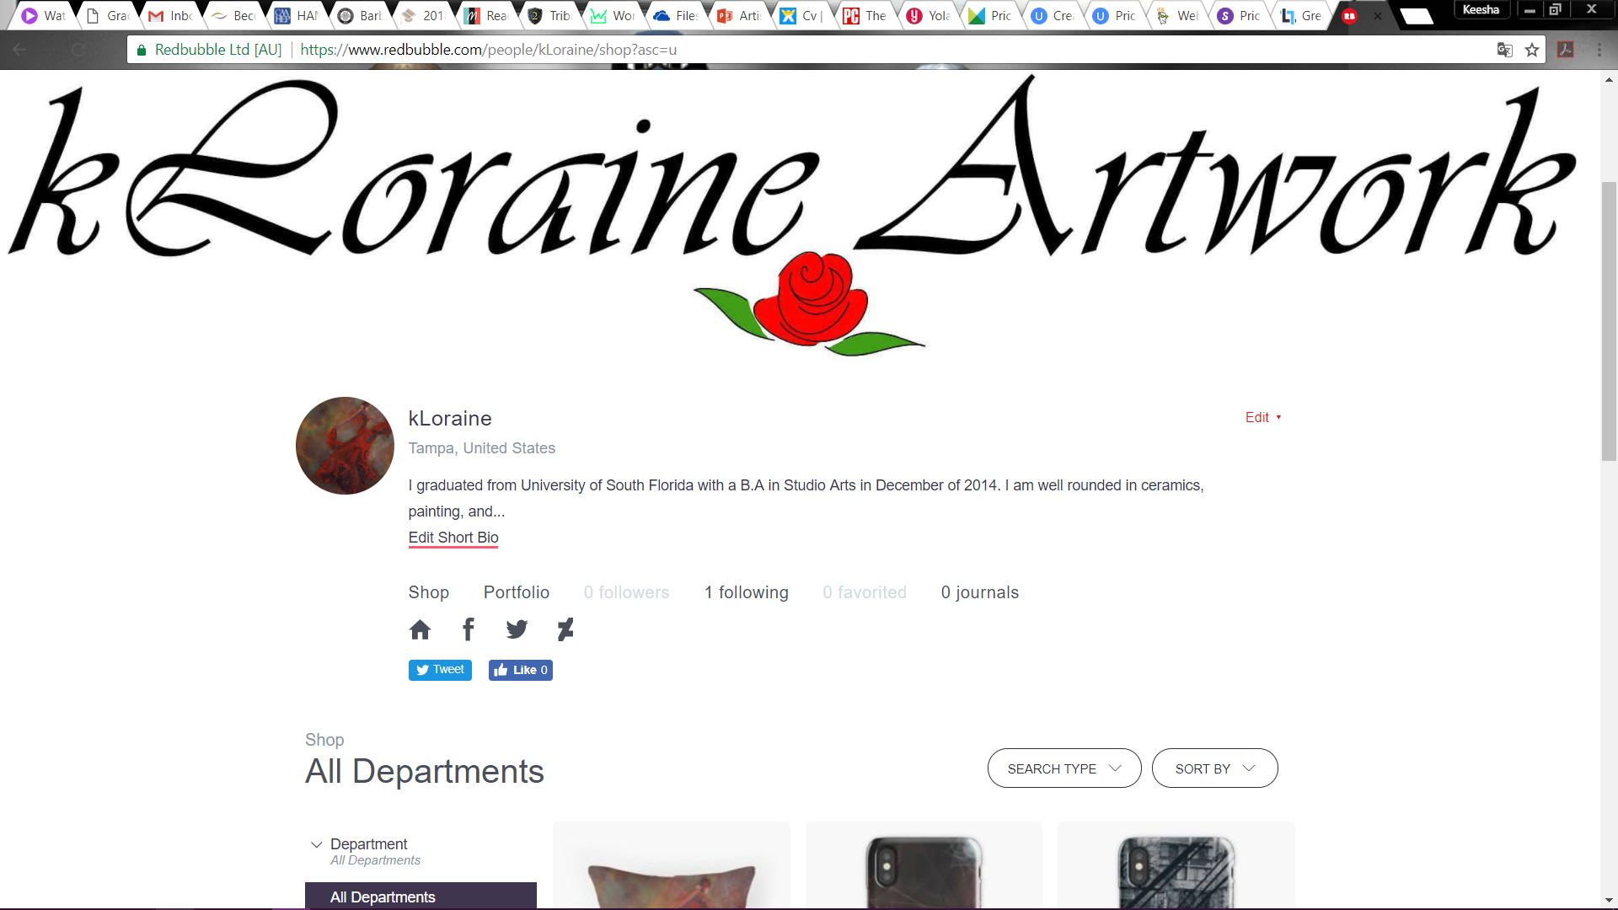
Shop

Slide 25
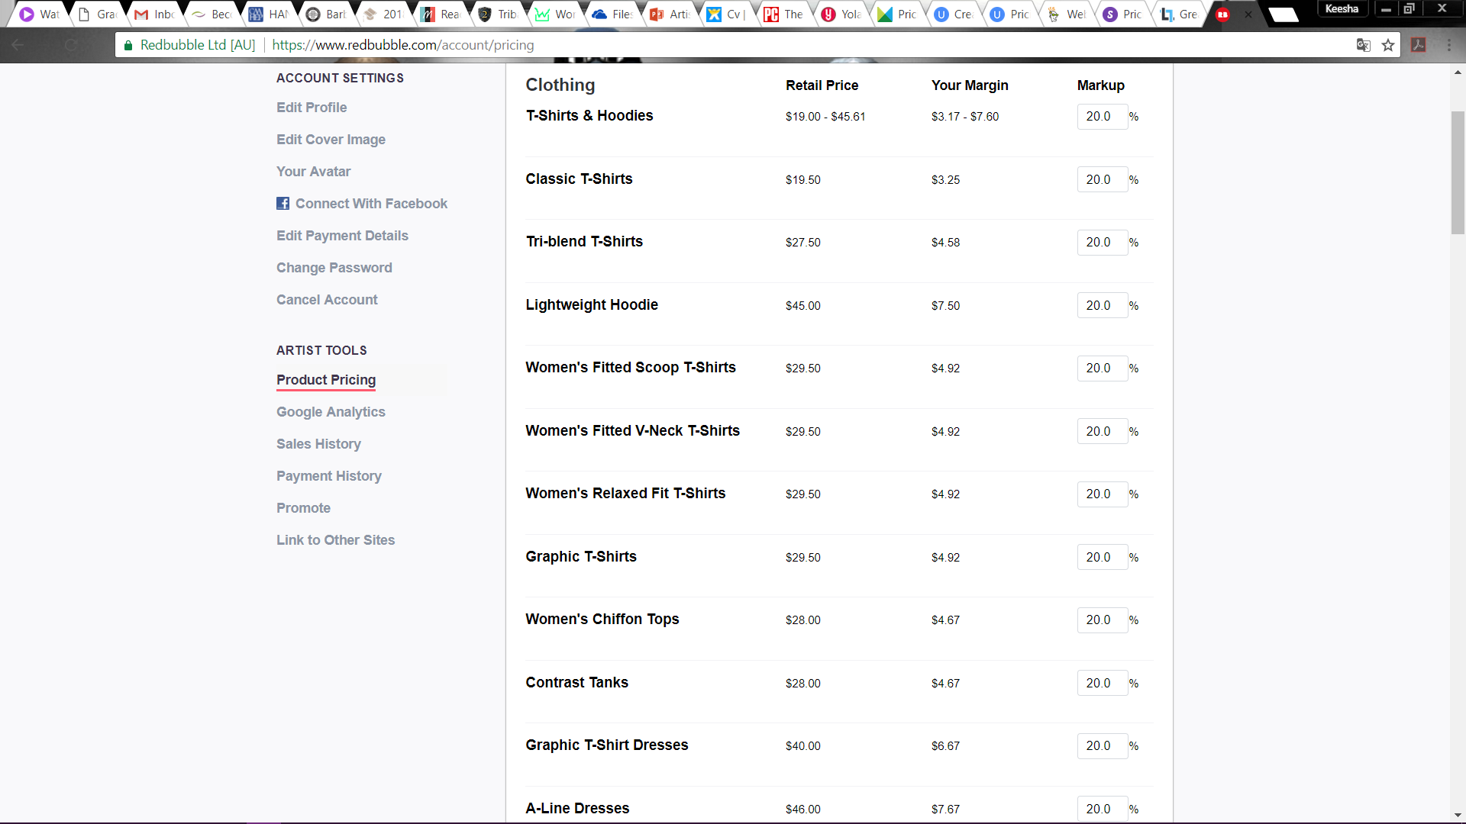
Shop

Slide 26
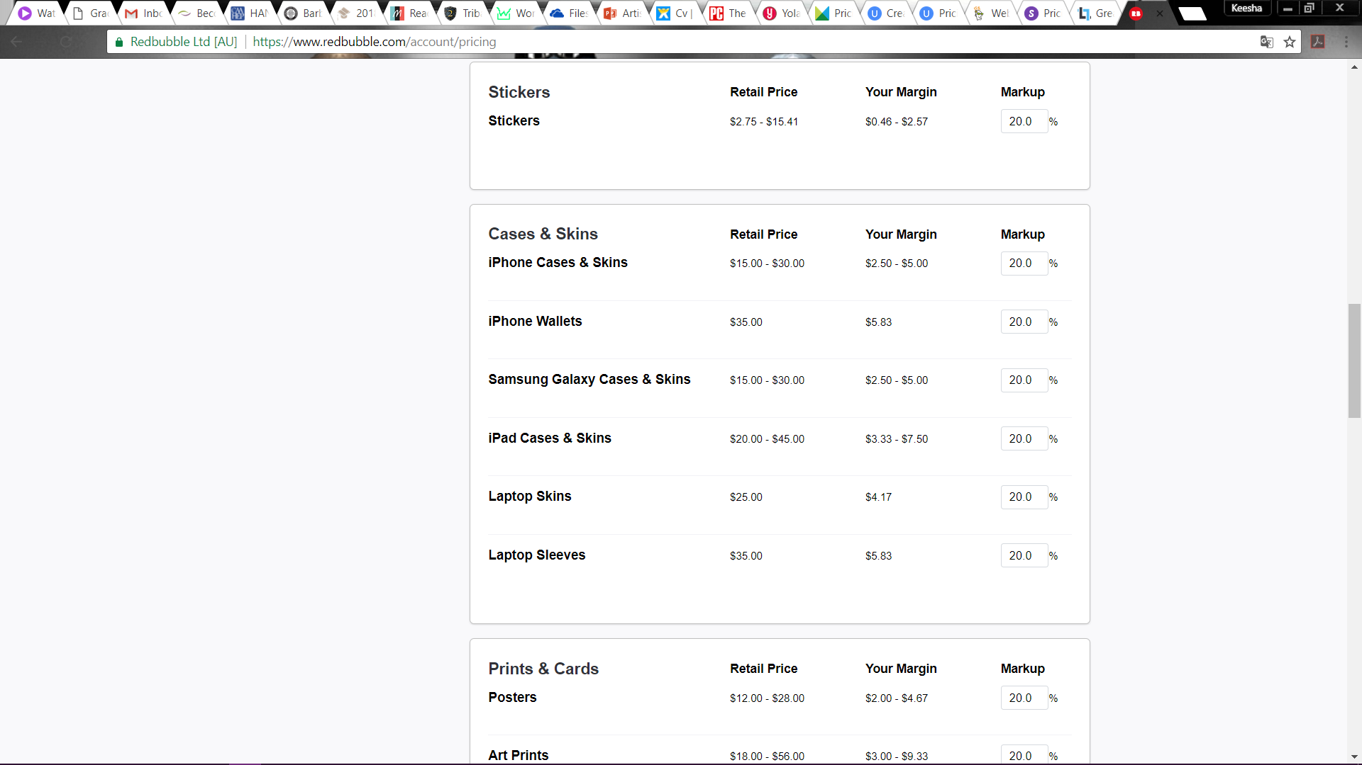

Slide 27
Social Media

Slide 28
Do I need Social Media?
Not necessarily
Acts like a landing page
People see progress of work or events
More foot traffic

Slide 29
Which one do I need?
Popular Choices
Advanced Choices
www.facebook.com
www.twitter.com
www.instagram.com
www.tumblr.com
www.paetron.com

Slide 30
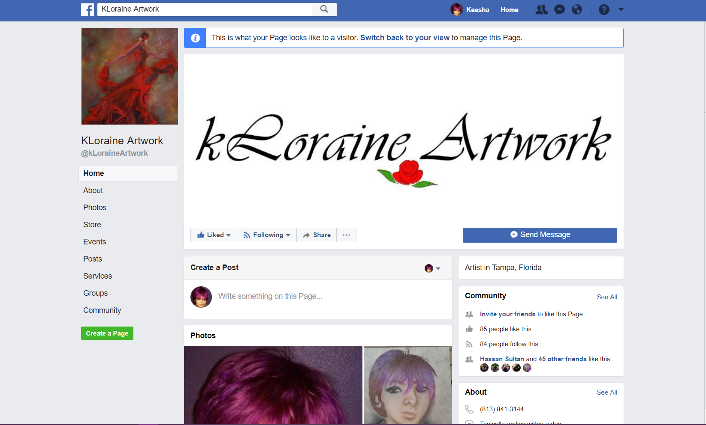

Slide 31
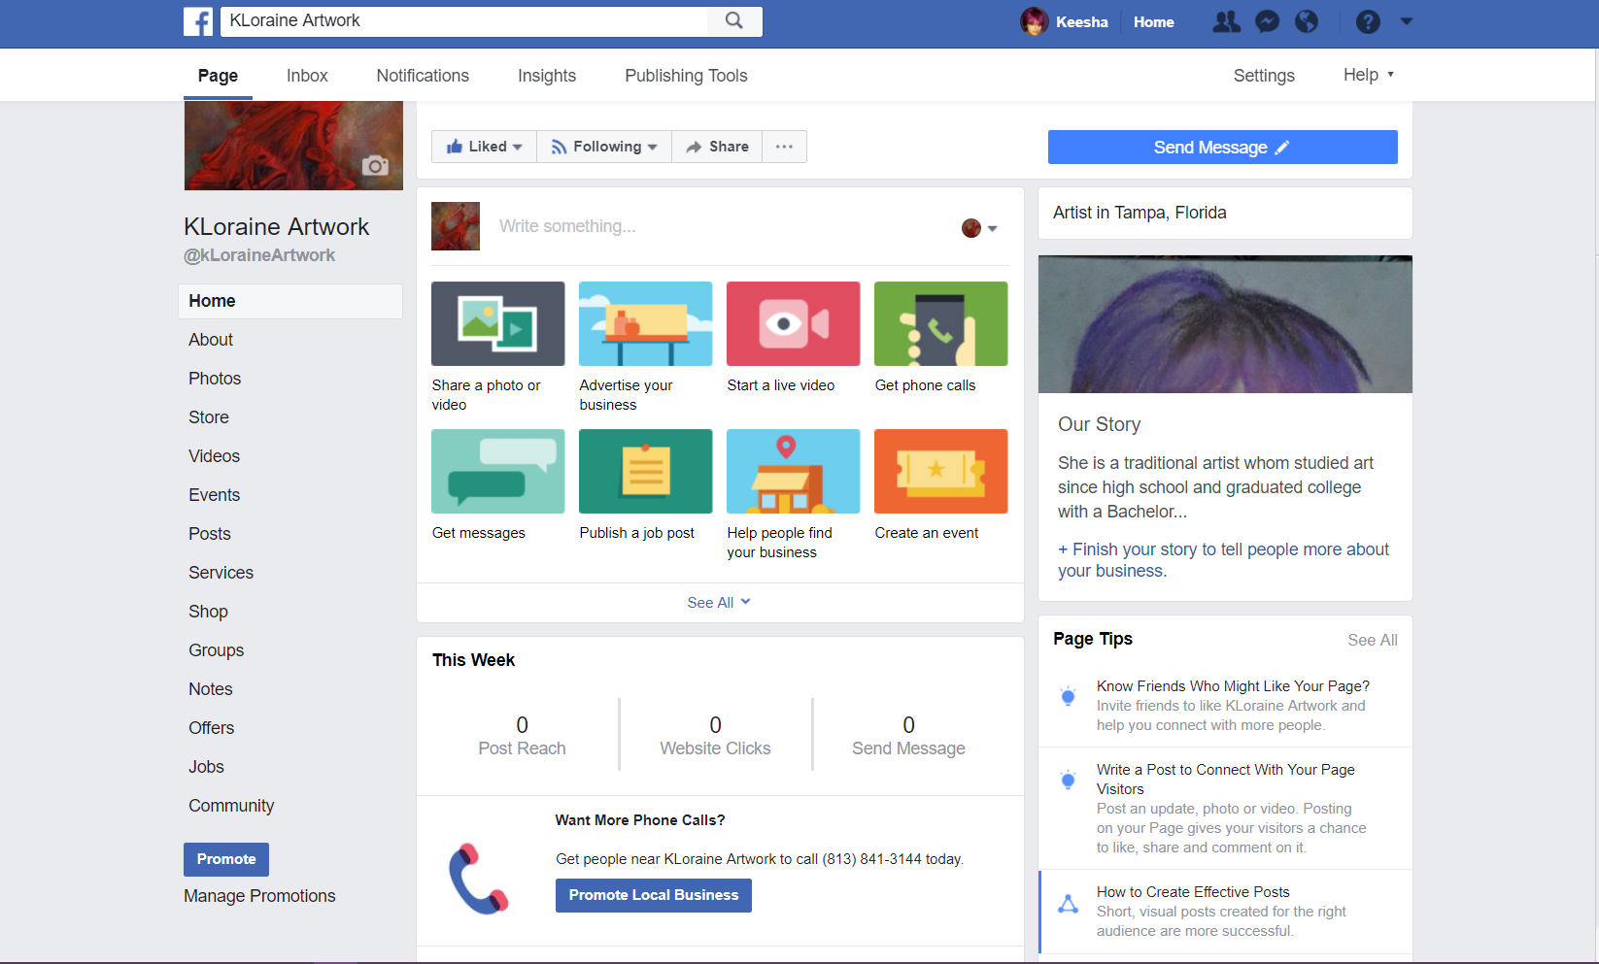

Slide 32
ANY qUESTIONS?

